Slide 1



HAND GESTURE RECOGNITION FOR DEVICE CONTROL
Project Exhibition - 1

Slide 2
TEAM
Ishit Chhabra 23BCE10958
Ishan Rai 23BCE11718
Nakshatra Thange 23BCE11194
Gauri Makker 23BCE11131
Prachi Singh 23BCE11342
Supervisor : Dr. Jitendra P.S. Mathur

Slide 3
OVERVIEW
Abstract
Methodology
Introduction
Result
Problem
Conclusion
Objectives
Reference

Slide 4
INTRODUCTION
Hand gesture recognition for device control is an innovative technology that enables intuitive, touchless interaction with a variety of devices. Using a webcam and advanced image processing techniques, such as OpenCV and TensorFlow, this technology identifies and interprets hand gestures to perform simple tasks like playing or pausing videos, switching slides, or controlling smart home devices. The system leverages machine learning to recognize common gestures (e.g., swiping, thumbs-up), offering a natural and accessible way to interact with technology, reducing the need for physical touch or traditional input devices like keyboards and remotes

Slide 5
EXISTING WORK WITH LIMITATIONS
Existing Methods:
Touch-Based Control: Requires physical interaction; inconvenient when hands are occupied or in hygiene-sensitive situations.
Voice-Controlled Systems: Not reliable in noisy environments and not suitable for all users.
Limitations:
Limited gesture vocabulary.
Gesture ambiguity leading to incorrect recognition.
Sensitivity to lighting conditions and background noise.
Occlusion of the hand affecting recognition accuracy.

Slide 6
PROPOSED WORK
The goal is to create a user-friendly, contactless hand gesture detection system that can seamlessly interface with a variety of devices by recognizing and categorizing movements in real time.
Features of the suggested system
Real-Time Recognition of Gestures:
Recognize and categorize basic hand movements, such as thumbs-up, open palm, and left/right swipes.
Make sure the system reacts to identified motions precisely and promptly.
Functional Proficiencies:
Media Control: Switch between songs and play/pause videos and Volume Control
Brightness Control: Use gestures to control Brightness

Slide 7
Methodology
01
02
03
04
05
Data acquistion
Preprocessing the Data
Feature
Extraction
Real-Time Gesture Recognition
Device Control Integration

Slide 8
Data Acquisition
Gesture Dataset: Create or use an existing dataset of hand gestures. The dataset should include multiple classes of gestures, such as:
Swipe left/right
Thumbs-up
Open hand (for stopping)
Fist (for play/pause)
Capture a large number of gesture images for each class to ensure robust training.

Slide 9
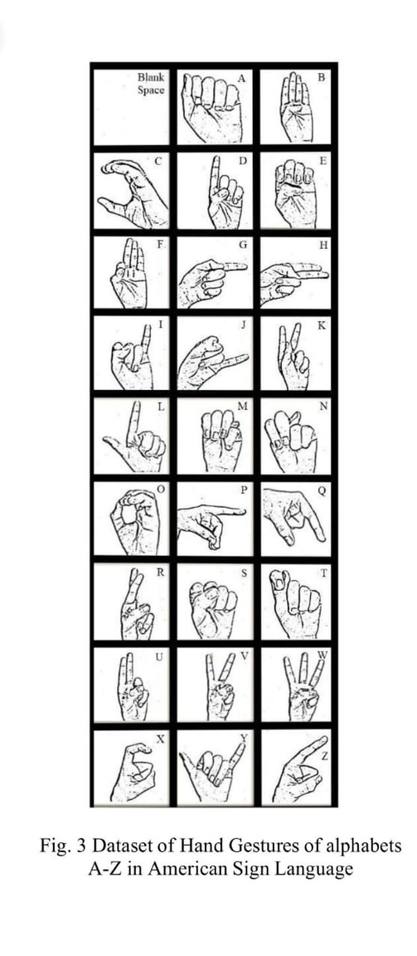
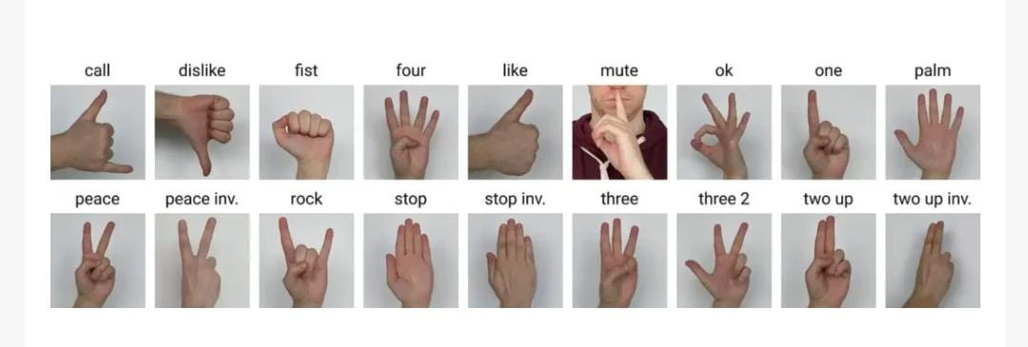

Slide 10
Feature Extraction
Convex Hull: Apply OpenCV’s cv2.convexHull() to find the convex boundary of the hand. This is useful to detect fingers and overall hand shape.
Convexity Defects: Analyze convexity defects to recognize the number of raised fingers (for gestures like ‘thumbs-up’ or swiping gestures).
Finger Detection: Count the number of fingers extended by calculating the convexity defects and use this to identify specific gestures.
Hu Moments: Extract shape-based features using Hu Moments, which are useful for classifying shapes of gestures.

Slide 11
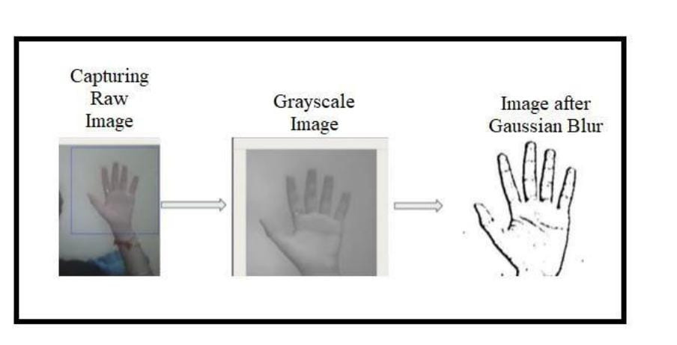
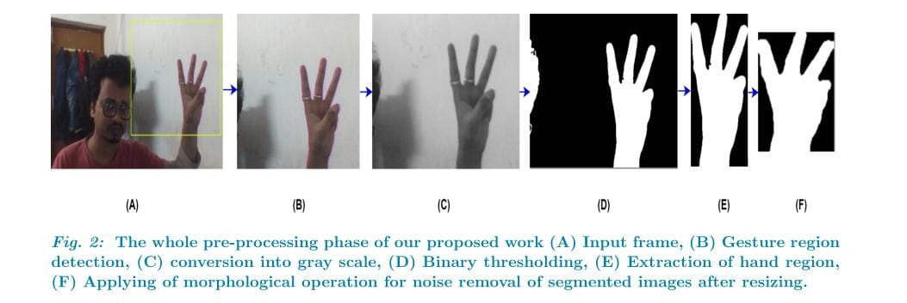

Slide 12
Gesture Recognition with ML
Prepare the gesture dataset with extracted features (e.g., hand contours, convexity defects).
Choose a machine learning algorithm to classify the gestures:
Convolutional Neural Network (CNN): Suitable for image classification tasks. You can train a CNN using TensorFlow or Keras by feeding the hand gesture images.
Support Vector Machine (SVM): For smaller datasets, SVM can be trained on the extracted feature vectors (such as contours, Hu Moments).
Training the Model
Split the dataset into training and testing sets.
Train the model using the training data and evaluate its performance on the testing set.
Use accuracy, precision, and recall as metrics to evaluate the performance of the model.
Once the model is trained, save it using TensorFlow/Keras or joblib to use it later for real-time gesture prediction.

Slide 13
Device Control Integration
Capturing Real-Time Input
Use the webcam to capture real-time video input via cv2.VideoCapture().
Continuously read frames and apply the same preprocessing steps
(grayscale conversion, contour detection) to the live input.
Gesture Classification
Pass the processed frames into the trained model to classify the gestures in real-time.
Use model.predict() to obtain the gesture class from the live video feed.

Slide 14
Device Control Using Recognized Gestures
Mapping Gestures to Actions
Define a mapping between the recognized gestures and specific control actions, such as:
Swipe left → Previous slide
Swipe right → Next slide
Thumbs-up → Volume up or start video
Fist → Play/pause video
Use libraries like PyAutoGUI to send commands to the system, such as:
Simulating key presses (e.g., for switching slides).
Mouse clicks or cursor movements.
Triggering smart device controls via APIs or IoT platforms.
Implementing Control Logic
Implement a loop that continuously monitors the gesture class output.
If a gesture is recognized, execute the corresponding action

Slide 15
NOVELTY OF THE PROJECT
KEY INNOVATIONS:
COMBINES MULTIPLE CONTROL FEATURES (VOLUME, BRIGHTNESS, CURSOR MOVEMENT) IN ONE SYSTEM.
REAL-TIME RESPONSIVENESS WITH LOW LATENCY.
ADAPTIVE GESTURE RECOGNITION UNDER VARIOUS CONDITIONS.
USER-FRIENDLY, TOUCHLESS INTERFACE THAT ENHANCES ACCESSIBILITY.
IMPACT:
BENEFICIAL FOR USERS WITH PHYSICAL DISABILITIES.
IMPROVES HYGIENE BY MINIMIZING PHYSICAL CONTACT.
ENHANCES CONVENIENCE IN PROFESSIONAL AND HOME ENVIRONMENTS.

Slide 16
REAL-TIME USAGE
Gesture-Based Smart Appliance Control: Use hand gestures to control smart home devices such as lights, fans, thermostats, and entertainment systems.
Immersive Gaming: Hand gestures can be used as input controls in VR/AR environments
Controlling Robots and Drones: Hand gestures can be used to guide or control robots and drones in real-time
Controlling Media Players: Use gestures like swiping left or right to change tracks or thumbs-up to play/pause videos or music on media devices without physically interacting with the remote or device
Gesture-Based Interaction in Public Spaces: Deaf and mute people can use hand gestures to interact with public services, such as ticket kiosks, ATMs, or information systems, where traditional audio communication is not possible.
Hand gesture recognition systems can be used to translate sign language into spoken words or text in real-time, enabling communication between deaf individuals and those who don't understand sign language
Gesture-Controlled Presentations: In classrooms or corporate environments, presenters can use hand gestures to navigate slides

Slide 17
HARDWARE & SOFTWARE REQUIREMENT
Hardware:
a.Webcam: For real-time gesture capture
b.Computer: For processing and running the application..
Software:
Python: For coding and system implementation.
OpenCV: For image processing and hand gesture detection.
TensorFlow/Keras: For gesture classification using machine learning.
Numpy: For array manipulations.
PyAutoGUI: For automating device control (e.g., simulating key presses or mouse clicks).
Pycaw: For volume control.
Screen Brightness Control Library: For adjusting screen brightness.

Slide 18
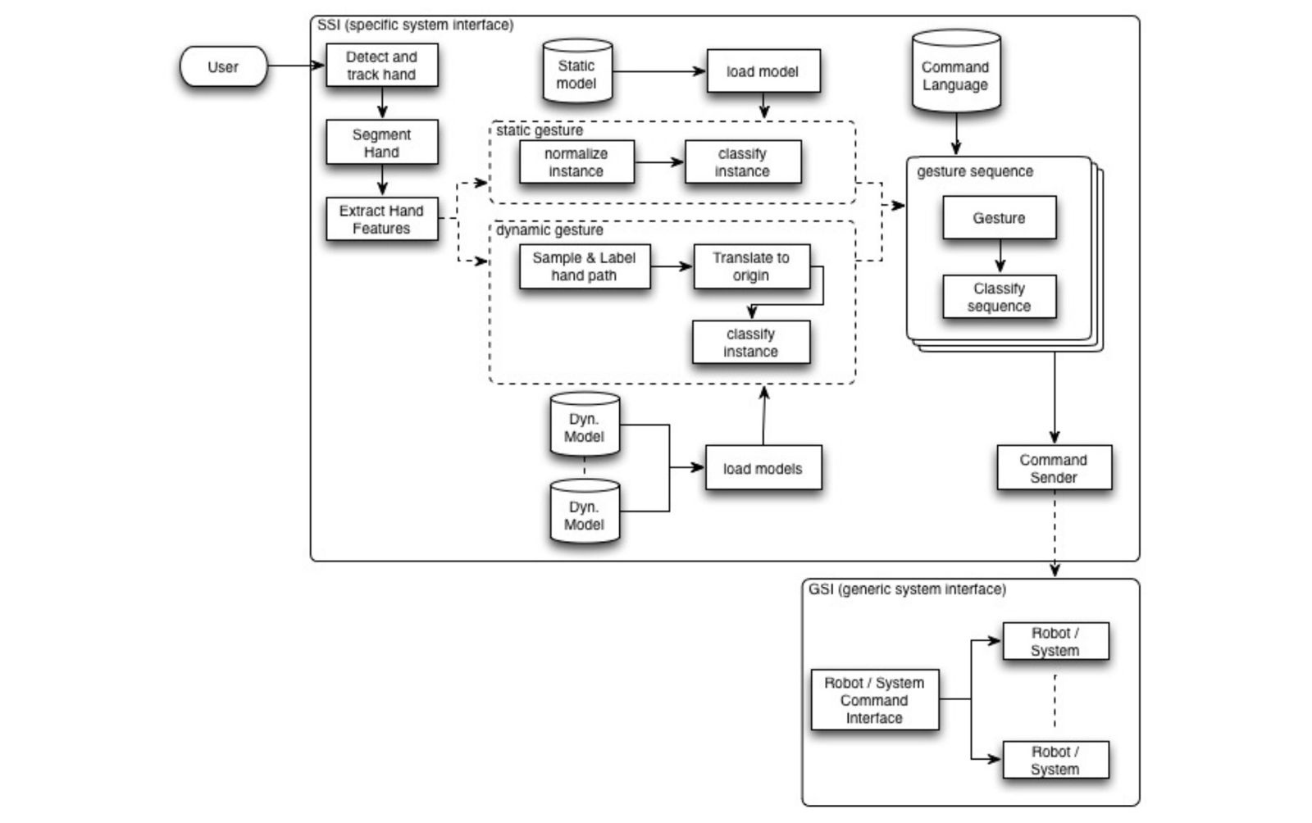
OVERALL SYSTEM ARCHITECTURE DIAGRAM

Slide 19
LITERATURE REVIEW
Hand Gesture Recognition facilitates touchless human-computer interaction, where users command devices using natural hand movements. With advancements in computer vision and AI, technologies like Mediapipe and OpenCV have made hand landmark detection easier. Mediapipe, known for its faster real-time processing, has become a popular choice. Deep learning methods, especially CNNs, classify gestures directly from images or landmarks, eliminating the need for manual feature extraction. However, challenges such as lighting sensitivity, gesture ambiguities, and occlusion still affect accuracy and limit the gesture vocabulary.
Applications of gesture recognition include:
Controlling smart home devices.
Assisting people with disabilities.
Enhancing virtual and augmented reality experiences.
The key challenges are achieving high accuracy across users and optimizing real-time performance with minimal latency. Research is focused on:
Expanding gesture vocabularies.
Improving real-time algorithms.
Addressing lighting and occlusion issues.

Slide 20
MODULE DESCRIPTION
HandRecog Class
It is the class that uses Mediapipe's hand tracking solution to track key points on the hand and return finger positions to classify gestures such as:
PALM All fingers extended.
FIST All fingers closed into a fist.
PINCH (Major/Minor) Thumb pinched with index or middle finger.or use of minor hand.
V_GEST Index and middle fingers extended in a "V" shape.
It includes methods to update the hand landmarks, set finger states, and return the gesture.
Controller Class
The controller class regulates the system activities according to the recognized gestures. This class offers functionality to control:
Volume: Changes system volume using a pinch gesture.
Brightness: Changes the brightness of the screen by detecting distance between fingers.
Cursor Movement: Moves the mouse cursor based on the position of the hand.
Click Action: It generates mouse click events if the palm gesture is sensed.
This class provides smooth transitions for volume and brightness by applying smoothing algorithms, thus preventing jarring transitions.
Main Function
The main function encapsulates everything and coordinates the workflow. It continually captures video from the webcam, processes each frame to recognize hand landmarks, classifies gestures using the HandRecog class, and then acts appropriately through the Controller class. The real-time video feed shows hand landmarks and responds to gestures immediately, providing an interactive touchless control experience. When the 'q' key is pressed, the program exits.

Slide 21
MODULE WORKFLOW EXPLANATION
Frames Captured
The workflow starts with capturing frames of real-time video with cv2.VideoCapture(). There is a continuous feed of images from the webcam, which is flipped upside down for a mirror effect, thus making it more intuitive.
Hand Landmark Detection
Each captured frame is processed through Mediapipe to detect 21 hand landmarks, such as fingertips and joints. These landmarks form the basis for identifying hand gestures. The hand-tracking model of Mediapipe ensures high accuracy and real-time performance.
Gesture recognition
Based on the detected landmarks, the HandRecog class analyzes finger positions and classifies gestures into categories like:
PALM: Open hand for clicking.
FIST: Fist closed for play/pause.
PINCH: Thumb and index/middle finger of minor and major Hand pinched for volume/brightness control.
V_GEST: Extend index and middle fingers to move cursor.
Action Execution
The Controller class maps every recognized gesture to a corresponding action:
Move Cursor: Moves the mouse based on hand position.
Volume Adjustment: The volume up or down using pinch motions.
Change Brightness: Modifies screen brightness dynamically.
Click Actions: Activates to simulate mouse clicks, an open palm is found.

Slide 22
IMPLEMENTATION AND CODING
This Python program implements a hand gesture recognition system using MediaPipe, OpenCV, and additional libraries.
The system captures hand gestures through a webcam and performs various tasks such as cursor movement, volume control, brightness adjustment, and clicking.
Each gesture corresponds to a predefined action, such as "pinch" for volume/brightness and "V" for cursor control.
It provides a hands-free interface for interacting with a computer

Slide 23
Code
1). Importing dependencies
import cv2
import mediapipe as mp
import pyautogui
import math
from enum import IntEnum
from ctypes import cast, POINTER
from comtypes import CLSCTX_ALL
from pycaw.pycaw import AudioUtilities, IAudioEndpointVolume
import screen_brightness_control as sbcontrol
cv2 (OpenCV): Handles webcam input and image processing.
mediapipe: Tracks hand landmarks and connections.
pyautogui: Controls mouse actions (cursor movement and clicks).
math: Performs mathematical calculations like distance between points.
IntEnum: Simplifies gesture classification with labeled enums.
pycaw.pycaw: Controls audio settings such as system volume.
screen_brightness_control: Adjusts screen brightness programmatically.

Slide 24
Code
2. Gesture and Hand Label Enum Classes
class Gest(IntEnum):
PALM = 0
FIST = 1
PINCH_MAJOR = 2
PINCH_MINOR = 3
V_GEST = 4
class HLabel(IntEnum):
MAJOR = 0
MINOR = 1
Gest Enum: Maps gestures to numeric labels for easier classification.
Example: PALM = 0, FIST = 1, etc.
HLabel Enum: Labels hands as MAJOR or MINOR for multi-hand scenarios.

Slide 25
Code
3. Hand Recognition Class
class HandRecog:
def __init__(self, hand_label):
self.hand_label = hand_label
self.finger_states = [False] * 5
self.gesture = None
Purpose: Encapsulates logic for recognizing hand gestures.
Attributes:
hand_label: Identifies the hand (e.g., major or minor).
finger_states: Tracks whether each finger is extended or folded.
Methods:
update_hand_result: Updates the detected hand landmarks.
set_finger_state:
Checks the relative positions of finger joints to determine if each finger is extended.
get_gesture:
Determines the gesture by analyzing finger_states.
Example: If all fingers are extended, the gesture is PALM.

Slide 26
Code
4. Controller Class
class Controller:
def __init__(self):
self.screen_width, self.screen_height = pyautogui.size()
self.volume_control = self.init_volume_control()
self.last_volume = 0.5
self.last_brightness = None
Purpose: Manages system controls (volume, brightness, cursor).
Attributes:
screen_width and screen_height: Dimensions of the screen.
volume_control: Audio control interface (initialized using PyCAW).
last_volume and last_brightness: Store previous values for smooth transitions.
Key Methods:
Initializes PyCAW for controlling system volume.
Smooths transitions between current and target values.
Adjusts volume based on the distance between thumb and index finger (PINCH_MAJOR).
Adjusts screen brightness based on PINCH_MINOR.
Moves the mouse cursor based on the position of the index finger (V_GEST).
Performs a mouse click when the PALM gesture is detected.

Slide 27
Code
5. Main Function
def main():
cap = cv2.VideoCapture(0)
hands = mp.solutions.hands.Hands(min_detection_confidence=0.7, min_tracking_confidence=0.7)
controller = Controller()
try:
while cap.isOpened():
ret, frame = cap.read()
if not ret:
print("Failed to grab frame.")
break
frame = cv2.flip(frame, 1)
rgb_frame = cv2.cvtColor(frame, cv2.COLOR_BGR2RGB)
results = hands.process(rgb_frame)

Slide 28
Code
Initializes the webcam (cv2.VideoCapture) and MediaPipe Hands (mp.solutions.hands).
Processes frames in a loop:
Converts the frame to RGB for hand detection.
Detects hand landmarks using MediaPipe.
Gesture Recognition and Control:
if results.multi_hand_landmarks:
for hand_landmarks in results.multi_hand_landmarks:
hand_recog = HandRecog(HLabel.MAJOR)
hand_recog.update_hand_result(hand_landmarks)
hand_recog.set_finger_state()
gesture = hand_recog.get_gesture()
controller.move_cursor(gesture, hand_landmarks)
controller.change_volume(gesture, hand_landmarks)
controller.change_brightness(gesture, hand_landmarks)
controller.click(gesture)

Slide 29
Code
Detects gestures using HandRecog and performs corresponding actions using Controller.
Display and Exit:
cv2.imshow('Hand Gesture Recognition', frame)
if cv2.waitKey(1) & 0xFF == ord('q'):
breakfinally:
cap.release()
hands.close()
cv2.destroyAllWindows()
Displays the processed video with landmarks and exits on keypress

Slide 30
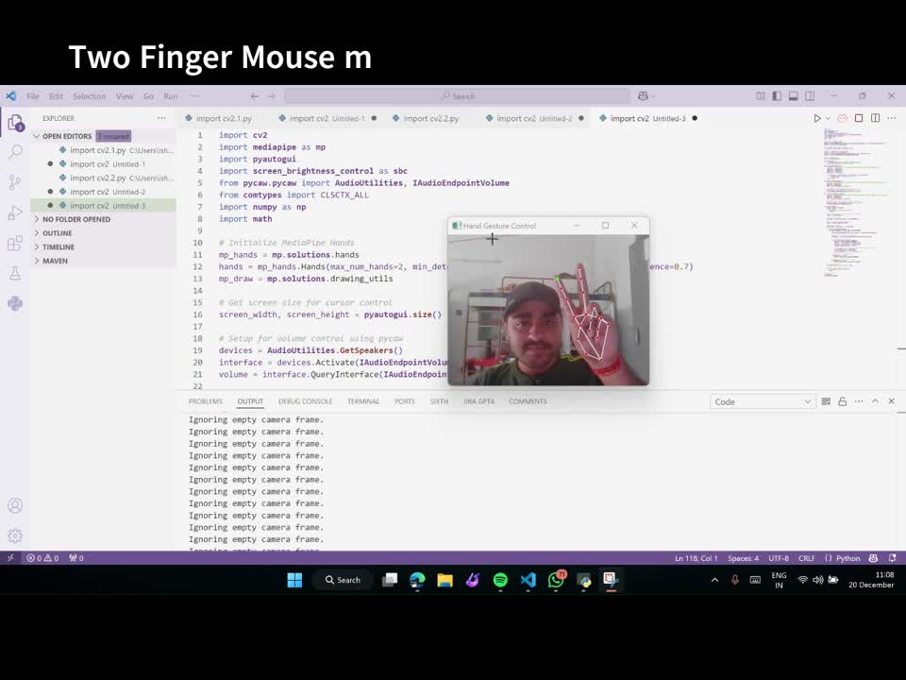
DEMO VIDEO

Slide 31
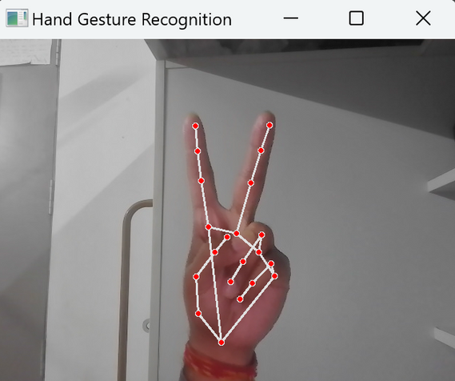
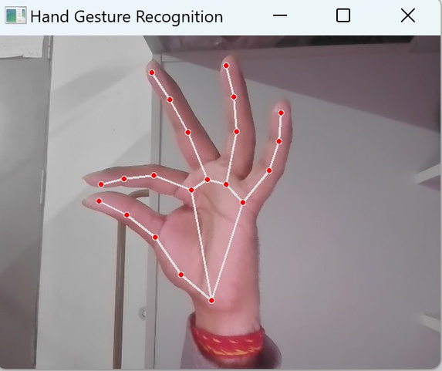
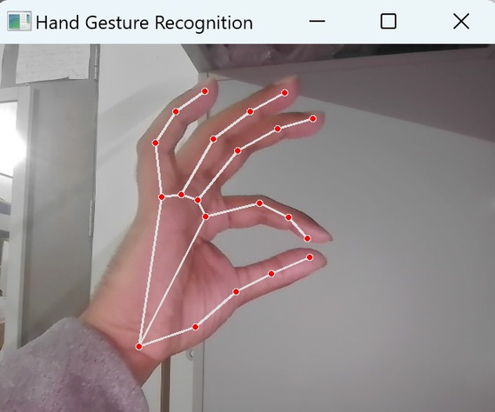
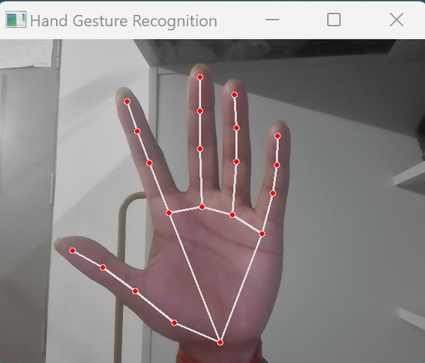
SNAPSHOTS OF PROJECT
DOUBLE FINGER TO CONTROL MOUSE POINTER
RIGHT HAND (MAJOR HAND) PINCH GESTURE FOR VOLUME CONTROL
LEFT HAND (MINOR HAND) PINCH GESTURE FOR BRIGHTNESS CONTROL
PALM GESTURE FOR FINGER MAPPING AND CLICK

Slide 32
TESTING
Testing the System: Test the system with various lighting conditions, different users, and different hand sizes to ensure robustness.
Performance Evaluation: Measure the response time, gesture recognition accuracy, and system latency to evaluate real-time performance.
Error Handling: Implement logic to handle false positives and missed gestures by refining the preprocessing and classification steps.

Slide 33
RESULT AND DISCUSSION
Inputs:
Hand gestures captured via a webcam in real time.
Gestures include predefined actions such as palm, fist, pinch, and V-gesture.
Outputs:
Cursor Movement: Gestures control the movement of the cursor on the screen.
Volume Control: Hand gestures increase or decrease the system volume.
Brightness Adjustment: Gestures allow for adjusting screen brightness levels.
Click Actions: Specific gestures trigger left or right mouse clicks.
Performance:
The system achieves high accuracy in well-lit conditions.
Real-time responsiveness provides a seamless user experience.
Effective for smart home automation, media control, and assistive technology applications.
Challenges:
The system faces issues with low-light environments, gesture ambiguity, and hand occlusions.
Different hand sizes and skin tones can occasionally affect recognition accuracy.
Discussion:
The system performs reliably under ideal conditions, demonstrating its potential for practical use.
Improvements in gesture recognition algorithms and lighting adaptability will enhance its robustness.
Addressing current challenges will make the system more suitable for real-world applications across various domains.

Slide 34
CONCLUSION
We have developed the system of real-time hand gesture recognition, enabling intuitive as well as touchless command for devices.
The system can apply computer vision techniques, work on Mediapipe through hand landmark detection, as well as apply machine learning models for the classification process.
It is able to control actions like cursor moving, volume, and changes in brightness.
The system shows high accuracy in well-lit environments and is useful for applications in smart homes, assistive technology, gaming, and public interfaces, providing a seamless, hygienic interaction experience.
Challenges and Future Work:
The challenges are lighting sensitivity, gesture ambiguity, and hand occlusions.
Future work will be on the following:
Extension of the vocabulary of gestures
Employing advanced deep learning models for increased accuracy
Optimization for low-light and real-world conditions
Dynamic gesture recognition
Reduced latency for real-time responsiveness.
Ensuring adaptability to different hand sizes and skin tones.
By meeting these challenges, the system would become robust, adaptive, and highly applicable, hence providing a versatile and accessible solution for touchless control of devices across domains such as healthcare, education, and virtual reality.

